Slide 1
Master of Science Applied Data Science
Syracuse University
Cherngywh Lee 334280765

Slide 2

Charlie Lee
Education
Syracuse University M.S. in Applied Data Science
YuanZe University B.S. in Mechanical Engineering
Professional Background
TPM III at Hyve Solutions
Principal Engineer of iphone team a Foxconn
Mechanical Architects at Supermicro
Mechanical Engineer at INVENTEC

Slide 3


Slide 4
Portfolio Milestone
Course list
IST 659 Data Admin Concepts & Database Management
IST 769 Advanced Database Management
IST 722 Data Warehouse
IST 687 Applied Data Science
IST 707 Applied Machine Learning
IST 664 Natural Language Processing
IST 772 Quantitative Reasoning in Data Science
IST 718 Big Data Analytics
IST 623 Introduction to Information Security
MBC 638 Data Analysis and Decision Making
SCM 651 Business Analytics
M.S. in Applied Data Science
The Applied Data Science program at Syracuse university’s School of Information Studies is a practitioner’s degree – while the curriculum is founded upon firm theoretical underpinnings, the program is designed to be a professional program with a strong emphasis on the applications of data science to enterprise operations and processes, particularly in the areas of data capture, management, analysis and communication for decision.

Slide 5
The Elements of Applied Data Science
Data Management
Well storage data with solid foundation of database building to various big data applications. Extract data to be data warehouse as the foundation of Business Analytics
Statistics & Analytics
Database & Information security
Business Analytics
Analyze data with statistics theory like normal distribution, hypothesis test...etc. as well as tool like fishbone diagram to explore and make a data driven decision
Model & Prediction
Find out useful variables, then applied various Machine Learning and Data Mining Model to interpret the data to predict the future
Machine Learning & Data Mining

Slide 6

Database & Information Security
Database is the foundation of Data Science, like a Grocery store to a Chef or Ammunition to the Army
Understand different types of data to build a secured database to clearly store structured data and conduct transaction
Deploy these data on a scalable and robust distributed systems like Hadoop, Data Lake to handle all types of big data
Eventually with Data Warehouse concept to perform ETL, create data sets that precisely fulfill the needs for Business Analytics

Slide 7
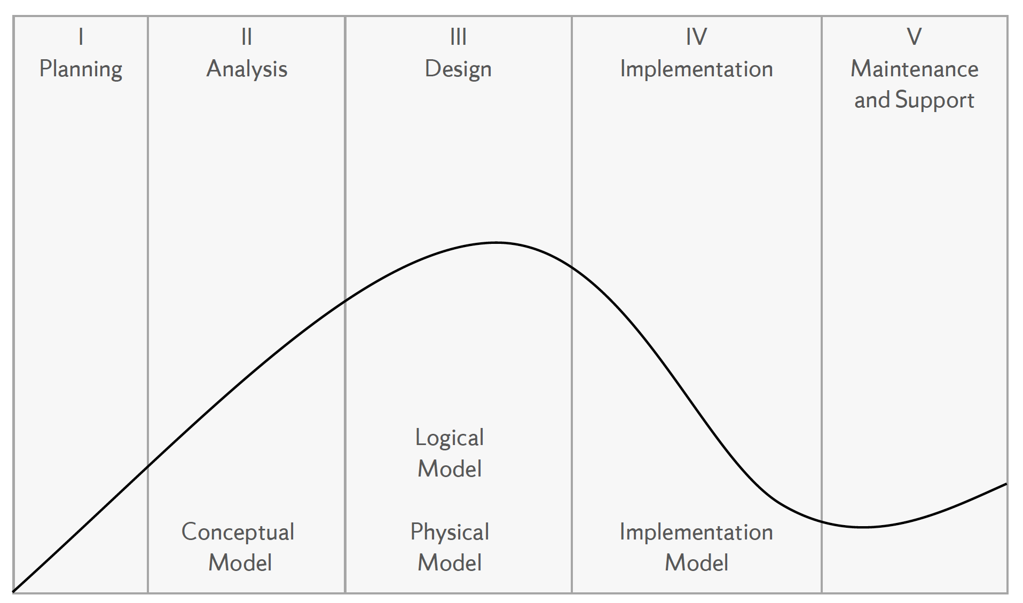
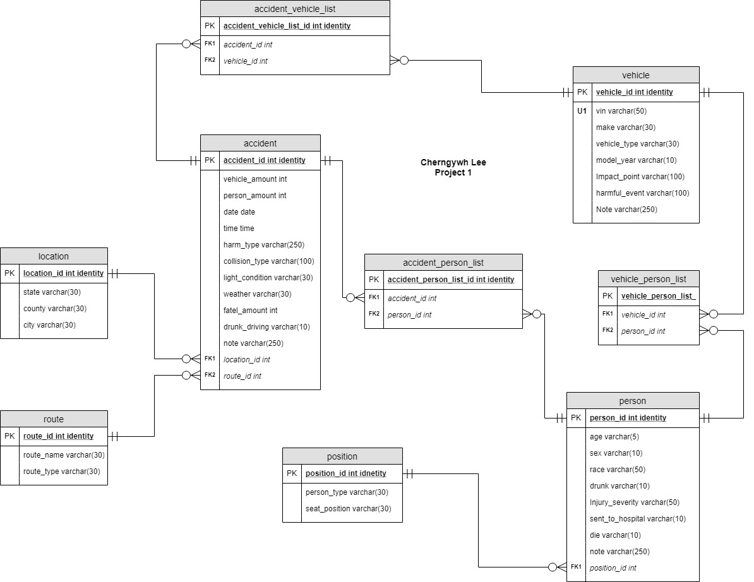
Build, Manage & Protect the Database
Examine data structures, file organizations, concepts, and principles of database management systems (DBMS) as well as data analysis, database design, data modeling, database management, and database implementation.
Follow the process below to build up a database from scratch:
Conceptual → Logical → External → Internal → Physical
Define the business rules and identification of the entities and relationships in the model. Set up attributes and keys and their types.
Solve Problems by constructing database queries using SQL
Recommend and justify strategies for managing data security, privacy, audit/control, fraud detection, backup and recovery with MS Access and SQL Server
Advanced concept and SQL skills with the relational data base model, such as transactions, concurrency control, performance and security. To build up a robust database can safely handle dynamic changes like temporal table.
T-SQL Transaction Commands like Commit, Rollback to meet ACID (Atomic, Consistent, Isolated, Durable)
Serializability and Locking Mechanisms to maintain concurrency control
Define permissions and securable to ensure database security

Slide 8
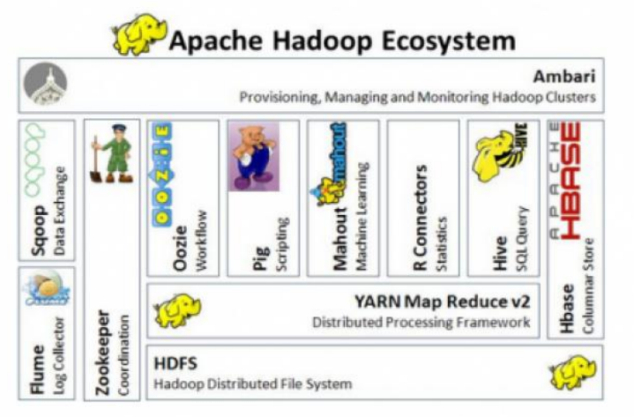
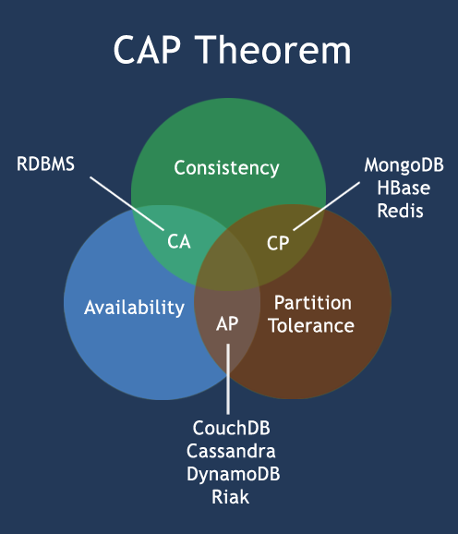
Big Data Application
CAP theorem can be used on all kinds of database system
CA – RDBMSs like Oracle, MySQL
CP – Single-master systems like MongoDB, HBase and HDFS
AP – Eventual consistency systems like CouchDB, Cassandra and Dynamo
No database can perfectly fulfill CAP theorem. However, we can freely combine any of them based on our needs per Polyglot Persistence
MongoDB – Product catalog and blog
Redis – Shopping cart and web page cache
Cassandra – Audit and activity logs
MySQL – Order processing and payments
Hadoop – Data analytics
Neo4j – Social graph
Hadoop is the way from data to big data by the scale out design. Following HDFS
Data is stored as it is and chunked into blocks and distributed to data nodes across a cluster and managed by a name node.
Data stored as they are, schema applied when data are read
Name Node is the master node to determine and maintain how the blocks of data
Data split into blocks and are distributed over physical Data Nodes
Default replication for failover

Slide 9


Slide 10
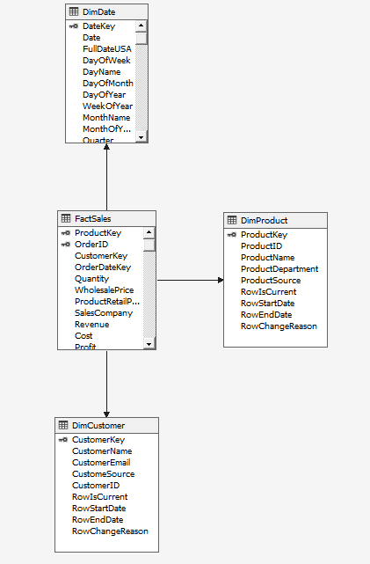
Data Warehouse Project – Questions & Actions
Data Warehouse is the foundation of BI (business intelligence).
In this project, we performed ETL (Extract, Transform, Load) form OLTP database to BI.
Data Introduction and Analytics Topics:
2 OLTP data sets – Fudgemart & Fudgeflix. Fudgemart is and online retailer and Fudgefilx is an online DVD seller by mail/video.
We have a few questions and improvement targets for these 2 data sets:
Who are the most frequent customers for Fudgemart?
What are the most profitable products for Fudgemart?
How do sales compare between Fudgeflix and Fudgemart? Profits and Revenues?
Identify Business Process to Model, these represent the data mart in the data warehouse:
Business Process and Gain – one row per product order to figure out who is the most frequent customer
Dimensions – Sales, Date, Order, Customer
Facts – Order amount, product price
Technical Steps:
Create a Star Schema, Data mart is implemented as a star schema in a RDBMS. It’s also called ROLAP

Slide 11
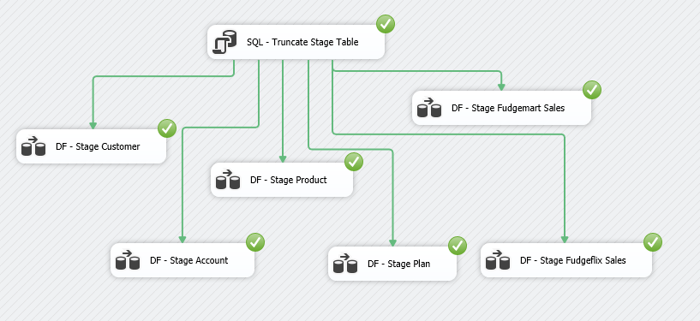
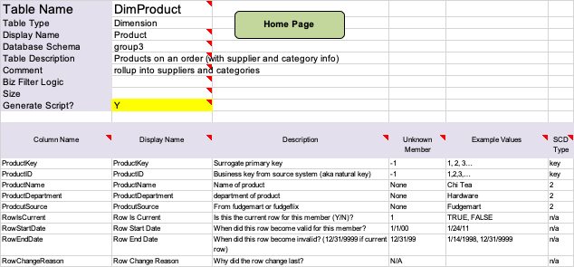
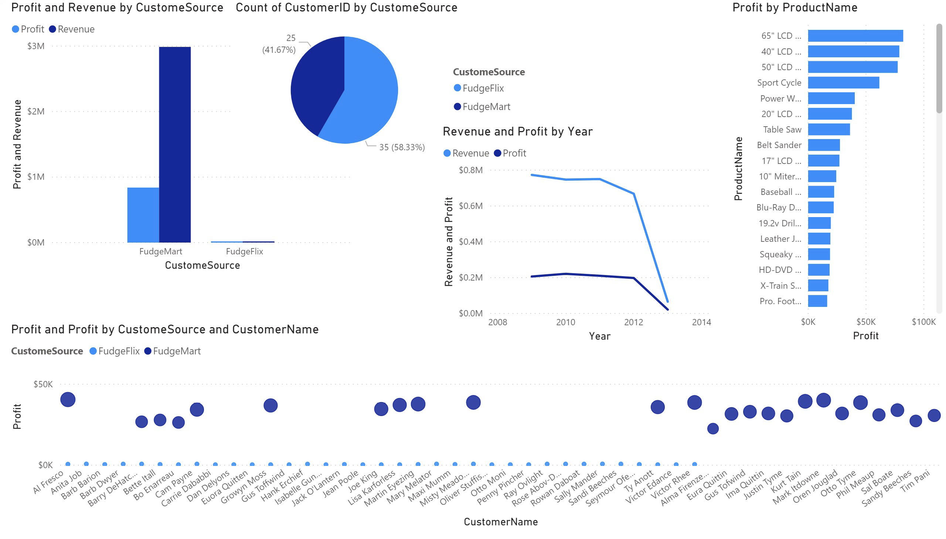
Data Warehouse Project - Actions
Define the attributes in each dimension from high-level to detailed-level
Perform ETL to extract data from OLTA to Data Warehouse based on the ROLAP
Conduct Data Analytics by BI tools with data from Data Warehouse

Slide 12
Statistics & Business Analytics
Explore data with statistical methods and technologies for analyzing historical data in order to gain new insight
Clearly figure out the root cause, strategically plan steps and actions to improve the performance to meet the business goal with various soft tools
Profoundly understand statistics and probability theory to analyze the nature of the datasets and the tendency underlying the data to make the best business decision

Slide 13
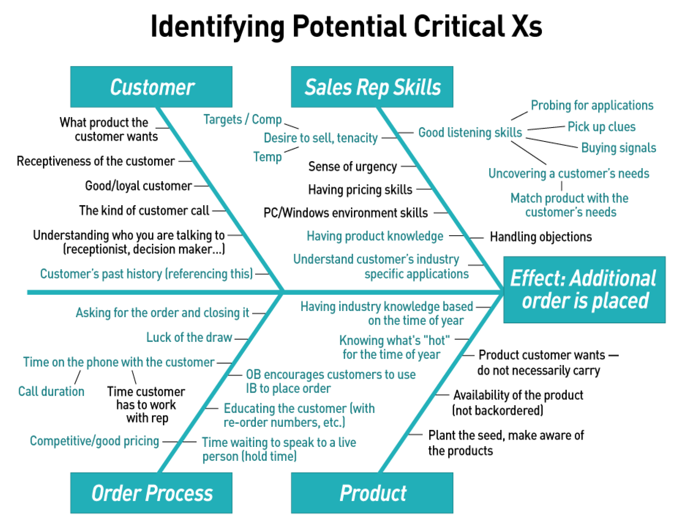
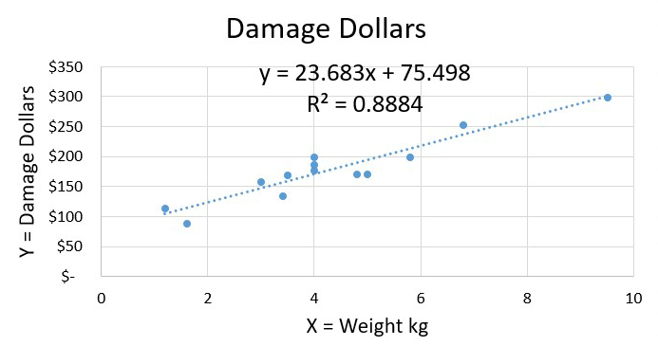
Quantitative Reasoning with Statistics
Soft Tools
Clearly evaluate the factors in an event with critical thinking framework:
DMAIC
Process Map
Affinity Diagram
Fishbone Diagram
Hard Tools
Analyze data with statistics mindset and knowledge:
Various Probability Distribution
Simple and Multiple Linear Regression
Logistic Regression
Performance Evaluation like R-Squared or Sensitivity Analysis
Bayesian and Traditional Hypothesis Testing
Tim Series Analysis
ML & DL application

Slide 14
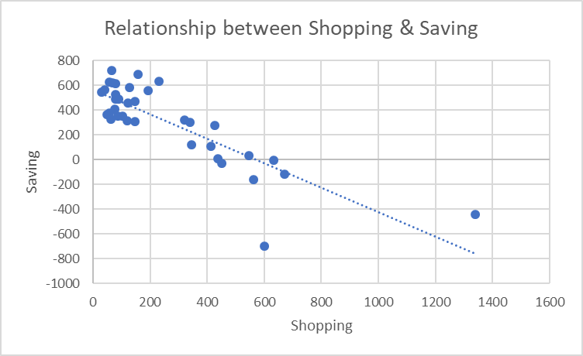
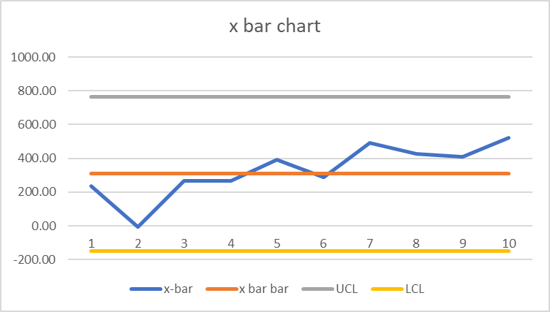
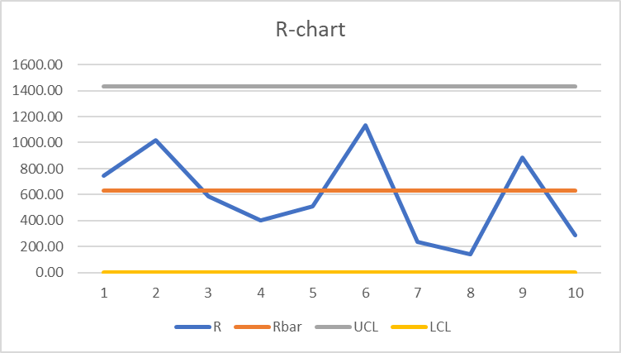
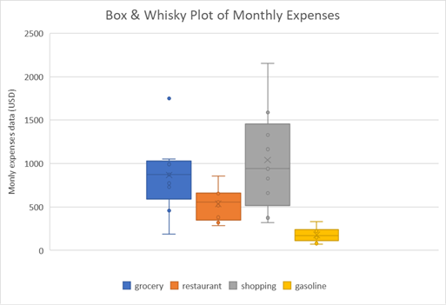
Define Business Questions and Improve with DMAIC methodology
Define 7/3
Measure 7/10
Analyze 7/17
Improve 8/15
Control 8/29
Monthly Saving was $1231.52 in average.
The goal was to save $518.4 more, Improvement Rare = 42%.
In order to extract more detail insight, the data set was prepared by week. Mean of Weekly saving is $307.88.
Determined the defect by the Mean. SQL of current saving was 1.85.
The purpose was to find the major expense. Figured out the factor with highest correlation coefficient to leverage the affect of actions we were going to take.
According to the plot, I decided to do some further Analyses on Grocery, Restaurant and Shopping.
Shopping is the major expense category which has a strong relationship with Saving because R = 0.82.
p = 0.0077 < α = 0.05, Chi-Square Test showed a strong evidence that I dined out more on Wednesday and Friday.
Stop browsing Amazon and Facebook coupon sharing group. Starting bringing lunch box on Wednesday and Friday.
Mean of Weekly Saving on August was $520.44.
Hypothesis Test showed that I made a significant improvement and SQL of saving is 6 now.
The improvement rate was actually 69% and beyond my original goal.
The trend of saving goes up but still within the limit. It makes me confident with this result. I’m capable of saving this much money.
Will take further actions when the saving become stable.

Slide 15
Machine Learning & Prediction
Predictive modeling solutions are a form of Data Mining by analyzing historical and generating model to predict the future
In order to let computer act like human to complete vast tasks like classify objects, determine true or false, find out unknown pattern and the trend in the future
Train it with all popular ML and DL algorithms with fundamental knowledge to fine tune the hyperparameters to reach a decent performance

Slide 16
ML & DL Algorithms
Supervised Learning
Classification
Learning patterns by labeled data and perform classification based on learned knowledge
K-Nearest Neighbor
Logistic Regression
Decision Tree
Random Forest
Naïve Bayes
SVM
Artificial Neural Networks
Image Recognition
Computer can recognize the image data and classify
Convolution Neural Network
Regression
To predict the future based on the data associated with time
Linear regression
Tim Series
To determine a mathematical relationship among several random variables
Multiple Linear regression
Unsupervised Learning
Directly cluster data without being given an answer. Find out the similarity and define the relationship based on data’s characteristics or frequency of occurrence
Association Rule Mining
K-Means
Hierarchical Clustering
Ensemble Learning

Slide 17


Slide 18
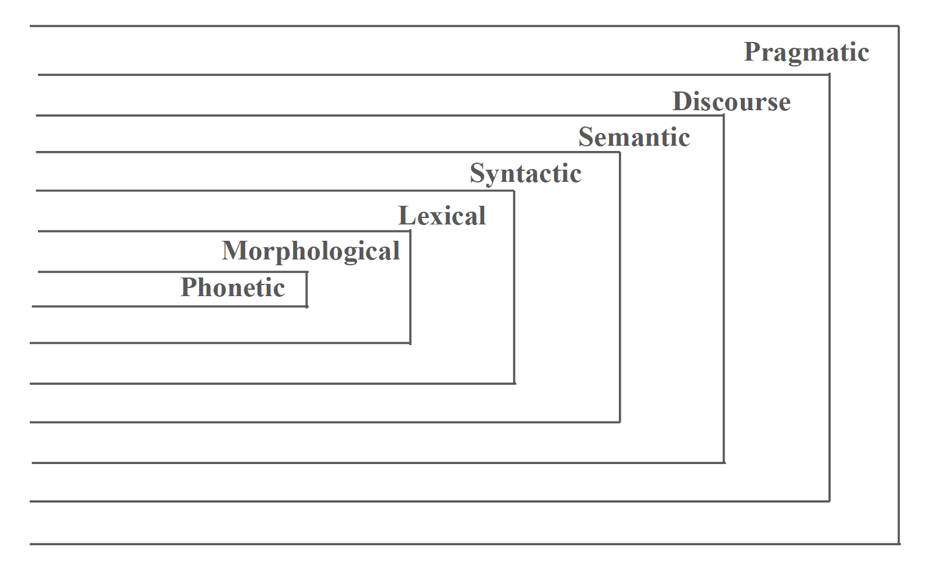
Natural Language Processing - Theory
NLP is a range of computational techniques for analyzing and representing naturally occurring tests at one or more levels of linguistic analysis for the purpose of achieving human-like language processing
Phonetic – Interpretation of speech sounds within and across word sound waves are analyzed and encoded into a digitized signal
Morphological – Deals with the componential nature of lexical entities like prefix and suffix
Lexical – Adding lexical class information to words, Part-of-Speech (POS) tagging tags words with specific noun, verb, adjective, and adverb types
Syntactic - Analyzing of words in a sentence to uncover the grammatical structure of the sentence. Break down the phase structure rules in a hierarchical way for Noun phrase, Verb phrase to Determiner, Noun…etc.
Semantic – Determining possible meanings of a sentence, extract the Semantic Relation between words
Discourse – Determining meaning in texts longer than a sentence and making connections between component sentences. For example, Introduction and conclusions are distinct patterns in a documents
Pragmatics – The purposeful use of language in situations to explain how extra meaning is read into texts without being encoded in them

Slide 19
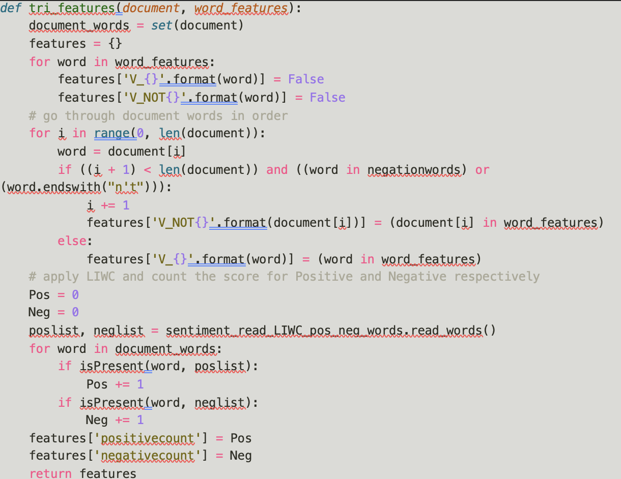
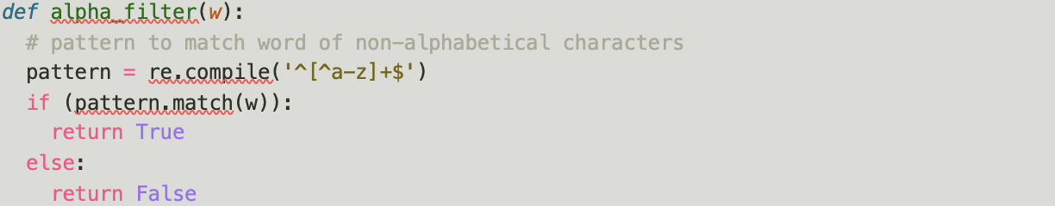
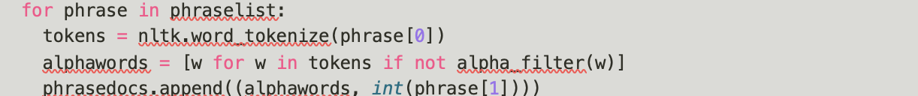
NLP Project – Data Preparation
Use Kaggle competition movie review phrase data (https://www.Kaggle.co/c/sentiment-analysis-on-movie-reviews) and labeled for sentiment to train a ML model for Sentiment Analysis. Socher’s group used crowd-sourcing to manually annotate all the subphrases of sentences with a sentiment label ranging over: Negative, Somewhat Negative, Neutral, Somewhat Positive, Positive.
Step 1: Pre-processing and filtering
Data cleaning for sentiment analysis. Because sentiment lexicon only contains alphabetic words, so need to remove punctuation and then tokenize words
Remove punctuation by alpha_filter function
Tokenize the words
Step 2: Create feature function
Trigram & POS Tag
Negation & LIWC

Slide 20
NLP Project – ML Model & Conclusion
Step 3: Train a Naïve Bay Model
Models predict 5 groups from Negative to Positive. Although Neutral is the major category with the most data and the best performance, we still need to average out all categories to evaluate the whole model.
The experiment with the best Precision score
Macro Average – Negation & LIWC
Precision: 0.431
Recall: 0.405
F1: 0.401
Micro Average - Baseline
Precision: 0.549
Recall: 0.519
F1: 0.520
The experiment with the best Recall score
Macro Average – Alpha Filter
Precision: 0.364
Recall: 0.406
F1: 0.373
Micro Average – Negation & LIWC
Precision: 0.532
Recall: 0.545
F1: 0.530
Conclusion:
In general, more data and folds has better performance. Randomly select 15000 phrases and run 10 folds on the data we clean in the formal steps.
After checking the precision of Neutral, we can see a limitation about 0.82. I think this is a fundamental limitation of the methods I used. I need to try more complex and profound methods, otherwise it may be just kind of a trade-off between Neutral and Non-Neutral (other 4 categories).
However, because this is about movie review, So I think we care about the review with strong sentiments more. It’s obvious that sentiment lexicons successfully made it.
Because the sentiment lexicon analyzes the sentence by words. It helps to figure more sentences with stronger sentiment. But maybe it’s too detail so sometimes it may misclassify some natural sentences like “I like the book version more” as positive. Hence it creates more type I error (Neutral but classified as Strong sentiment).
And because of it, type II error increased on “Neutral”. But again, I still think it’s a good result because we care about the reviews with strong sentiment more.
In conclusion, the performance of sentiment lexicons like LIWC and AFINN did a better job on finding out more sentences with sentiment. Whereas Alpha Filter and Trigram & POS tags are doing better on the general purpose.

Slide 21
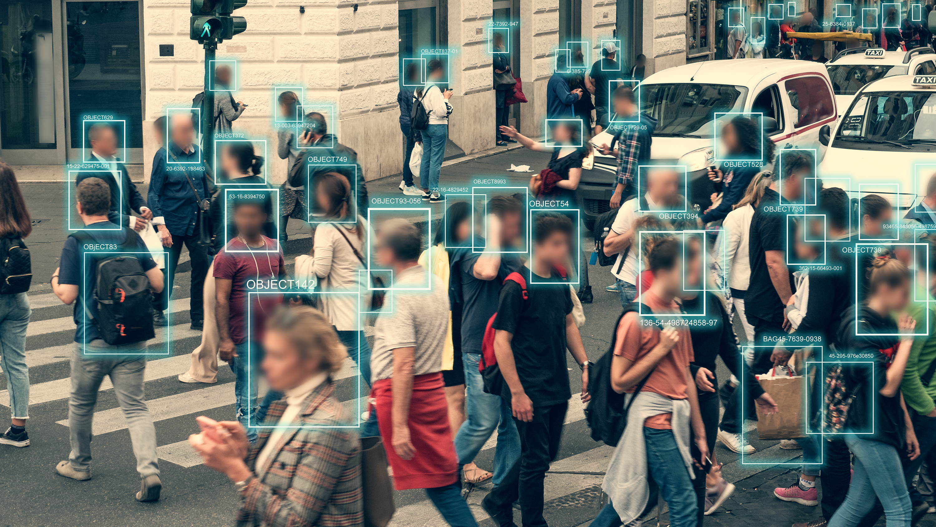
“Knowledge crowns those who seek her”

Slide 22
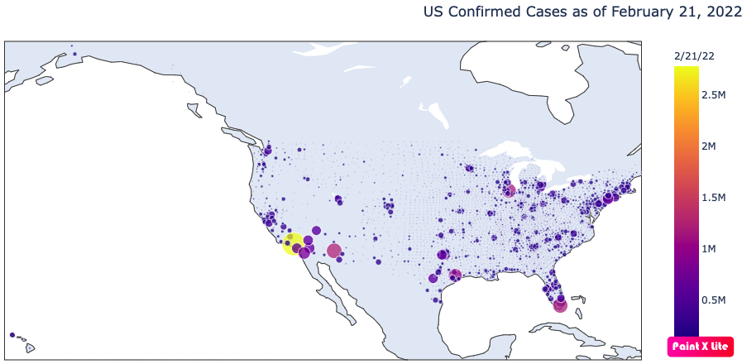
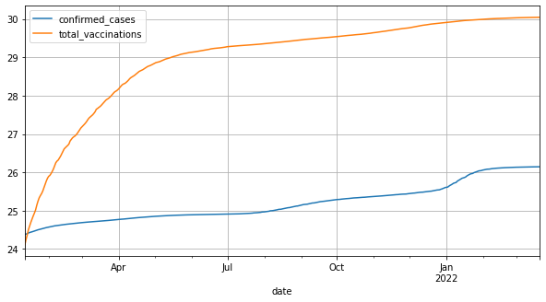
Big Data Analytics Project
This Data Analytics project is an approach by following OSEMiN to turn data into information
Step 1: Specify
What are the factors leading to higher amounts of confirmed COVID-19 cases? Need to prove our Hypotheses:
higher vaccination rates = fewer confirmed cases
more positive vaccine sentiment = higher vaccination rates
more positive vaccine sentiment = fewer confirmed cases
Step 2: Scrub
Which is also called Data Wrangling. Looking into the raw data and optimize the data quality by unifying data format, normalizing values and filling in unknown data with a meaningful value like mean or zero…etc.
In this case, we fill in NA with a mean of the previous day and the next day.
Step 3: Explore
Explore the data by creating visualization or a graph to gain an intuitive insight from the data

Slide 23
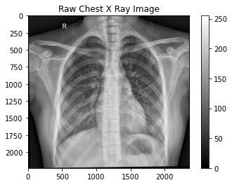
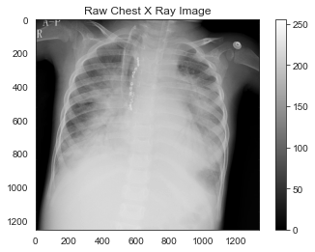
Big Data Analytics Project
Step 4: Model - CNN
Create a Deep Learning model to classify X-Ray image to quickly determine it’s Normal or Pneumonia.
Train set: PNEUMONIA = 3875, NORMAL = 1341
Test set: PNEUMONIA = 390, NORMAL = 234
Validation set: PNEUMONIA = 8, NORMAL = 8
We directly applied transfer learning by using champion models:
Densenet121, InceptionV3,
DenseNet: utilizes dense connections between layers, through Dense Blocks, where we connect all layers (with matching feature-map sizes) directly with each other.
Inception-V3: makes several improvements including using Label Smoothing, Factorized 7 x 7 convolutions, and the use of an auxiliary classifier to propagate label information lower down the network
EfficientNetB4: a novel model scaling method that uses a simple yet highly effective compound coefficient to scale up CNNs in a more structured manner.
Normal
Pneumonia
Model | Precision | Recall | F1 | Accuracy
DenseNet | 81.6% | 51.5% | 41.6% | 63.6%
Inception-V3 | 86.3% | 84.6% | 85.3% | 86.5%
EfficientNetB4 | 67% | 55.2% | 39% | 44.4%

Slide 24
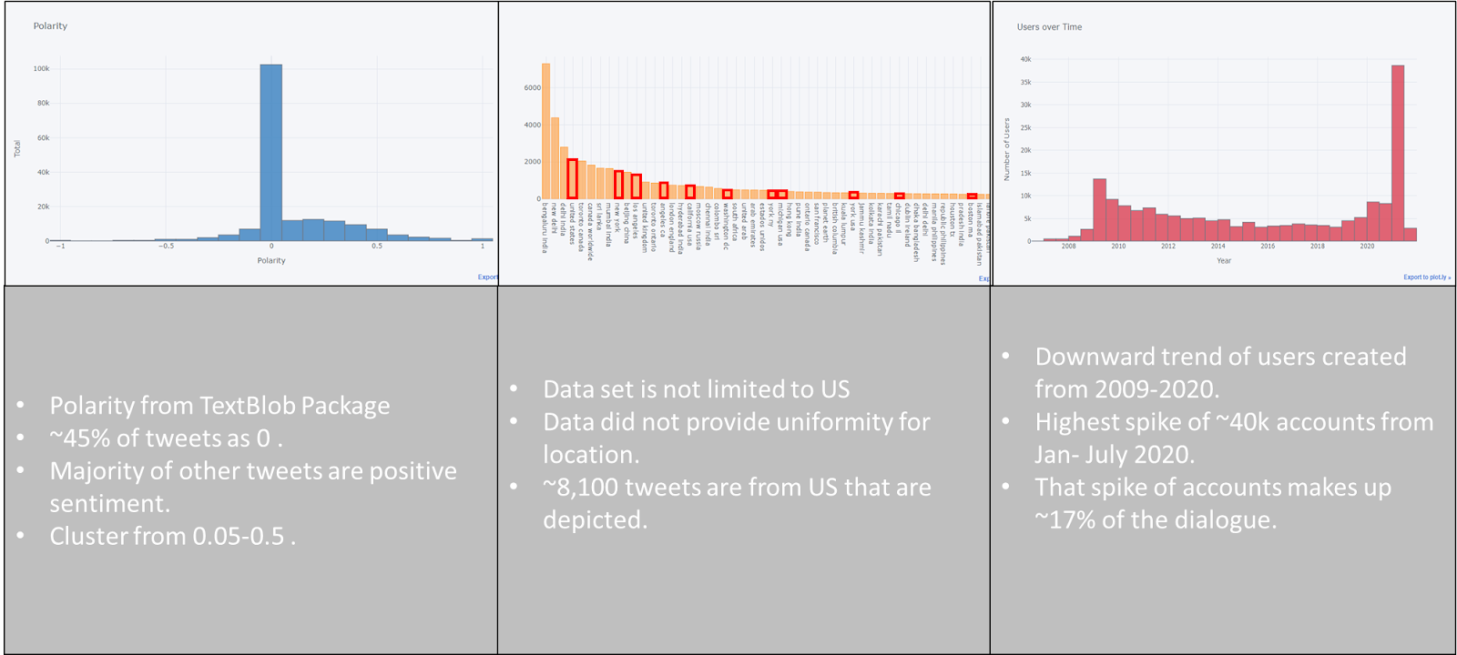
Big Data Analytics Project
Step 4: Model – Sentiment Analysis
Step 5: Data Observation
No correlation between cases per capita and state population
Vaccine sentiment in US leans more positive
More likely for a negative sentiment Tweet to be re-tweeted than positive sentiment Tweet
Higher raw numbers of vaccinations and COVID-19 cases correspond with population numbers
Higher amounts of vaccinations per capita follow political borders
Step 6: Recommendations
Be wary of Covid-19 info on social media; use reliable sources for information pertaining to Covid-19
Get vaccinated
Polarity from TextBlob Package
~45% of tweets as 0
Majority of other tweets are positive sentiment
Cluster from 0.05 ~ 0.5

Slide 25
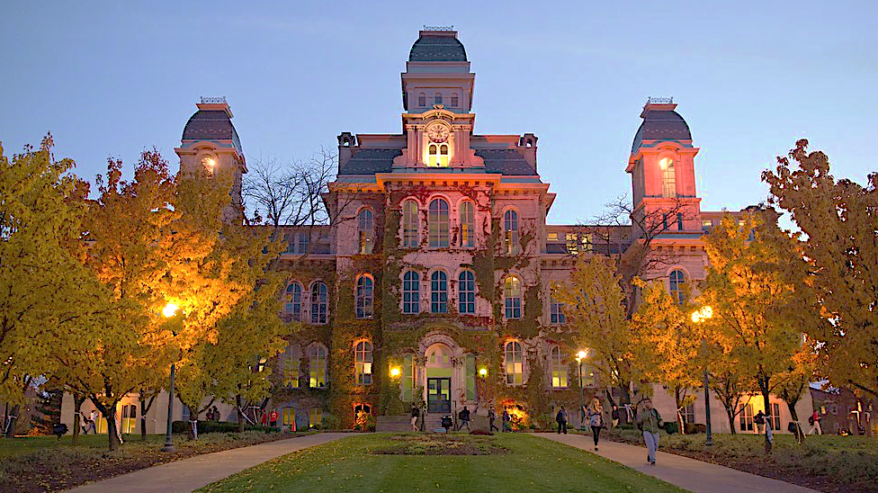

Slide 26
Summary of My ADS Journey
The path in the program that I selected is about data engineering. I took all classes from database foundation to real world application like data warehouse as well as more hardware related field like distributed file system (Hadoop). All these classes provide me a comprehensive knowledge from physical computer infrastructure to virtual data information extraction.
Not to mention the core courses which are focus on machine learning and analytics, I gained abundant hands-on experience to explore data, tell a good story with statistical thinking and predict the future with the model that built by AI. I’m confident and ready to be a data scientist to work in the industry.
In this program, I met many wonderful people, made new friends and learned from brilliant, knowledgeable professors from various fields. It’s a wonderful journey. Go Orange!!

Slide 27
Credits
Special thanks to all the people who made and released these awesome resources for free:
Presentation template by SlidesCarnival
Photographs by Unsplash
Photographs by Sutterstock
Photographs by https://www.syracuse.edu/about/social-media/images/

